Slide 1

Travel, Tourism & Hospitality Data Analytics
Mid-Project Review: Customer Retention & Dynamic Pricing Analysis

Slide 2
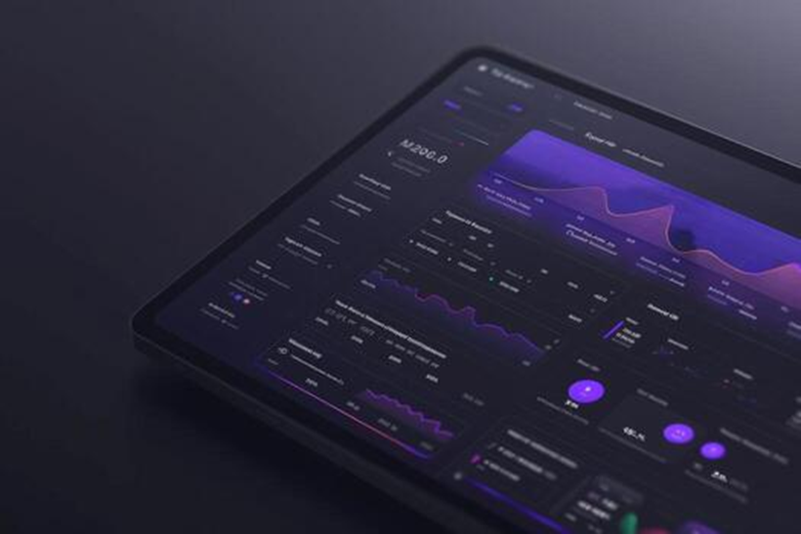
Project Overview
Core Objective: Identify the definitive historical and behavioral drivers behind hotel reservation cancellations.
Predictive Framework: Build a robust, machine-learning-backed model to accurately forecast at-risk bookings.
Business Value: Enable management to optimize dynamic pricing strategies, mitigate churn, and significantly reduce revenue loss.

Slide 3









Phases 1 & 2: Data Engineering & EDA
Price Sensitivity
Channel Risk
Lead Time Danger
A strong positive correlation exists between Average Daily Rate (ADR) and churn. Higher prices directly increase the likelihood of price-shopping and cancellations.
Reservations originating from Online Travel Agencies (OTAs) exhibit a drastically higher cancellation rate compared to direct or corporate bookings.
Bookings made well in advance carry a significantly higher churn probability than last-minute reservations, requiring proactive engagement.

Slide 4

Phase 3: Predictive Modeling
Transitioned from historical analysis to a robust predictive model, engineering new time-series metrics while actively removing retrospective data-leakage columns.
77%
We overcame severe target class imbalance by utilizing Standard Scaling and applying balanced class weights. The resulting Logistic Regression classifier achieved exceptional accuracy in identifying at-risk bookings.
Cancellation Recall Rate

Slide 5

Phase 4: Business Intelligence
We successfully exported the cleaned, scored dataset and established a robust Star Schema architecture within Power BI.
Our central Fact table is fully operational and strictly mapped to contextual dimension tables (Hotel Type, Market Segment). Initial DAX measures are tracking core executive KPIs.
All backend scripts and visualizations are secured via Git version control on our dedicated development branch.

Slide 6



Status & Next Steps
Current Project Status We are currently operating ahead of schedule with zero technical blockers. The foundational data architecture is complete.
Visual Dashboard Deployment Focusing heavily on the UI/UX front-end build. We will be integrating interactive slicers and clustered bar charts to visualize churn by market segment.
Final Reporting & Delivery Upon dashboard completion, we will merge the development branch and compile the final data-driven business recommendation report.

Slide 7
Questions?
Thank you for your time. Happy to discuss the methodology, the machine learning model, or our Power BI architecture.

